Slide 1
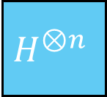










Grover Operator ($G=−DZ_{f}$)
Diffusion Operator($−D$)
$$Z_{f}$$
$$H^{⊗n}$$
$$H^{⊗n}$$
$$Z_{OR}(=−Z_{0})$$
$$H^{⊗n}$$
$$|0⟩$$
n
$$|0⟩$$
$$|0⟩$$
a
Repeat $O(\sqrt{N})$times

